Slide 1


DO video games HAVE A POSITIVE OR NEGATIVE EFFECT ON mental health symptoms?
tasha polk Data scientist

Slide 2

Introduction
My Name is Tasha Polk, I’m 39 years old and I’m a single mother of 2 amazing small humans.
I graduated from Middle Tennessee State University in 2007 with a Major in Business Administration and a concentration in Marketing.
I’ve worked in Healthcare for over 10 years. I currently work for United Healthcare building healthcare plans for employer provided health plans.

Slide 3
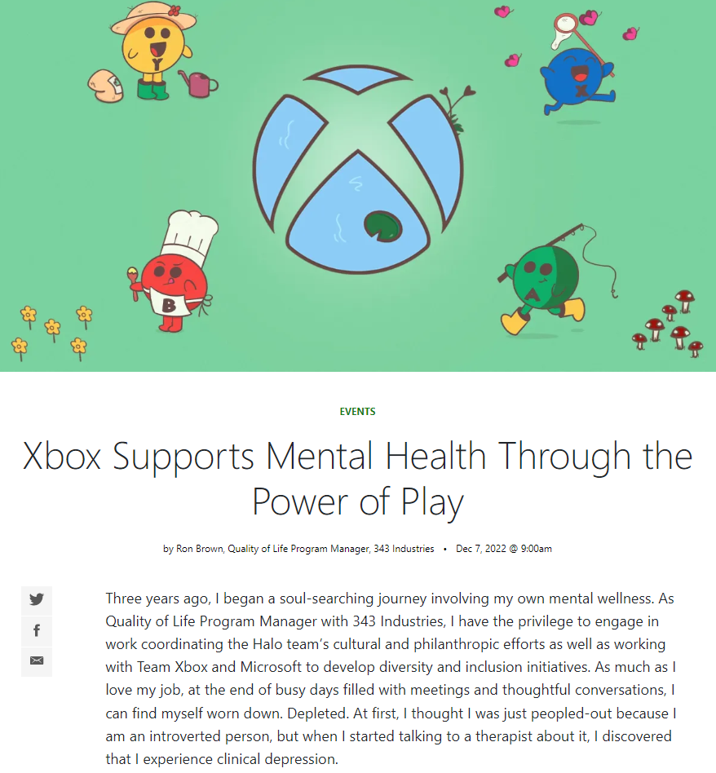

Gaming companies are starting to market and develop games that help gamers with mental health symptoms.
https://news.xbox.com/en-us/2022/12/07/xbox-supports-mental-health-through-power-of-play/

Slide 4

One of many studies becoming more available
The NIH conducted their own study compiling many different reliable sources, the conclusion of their study states,“…the overall accessibility and pervasiveness of commercial video games within modern society positions them as an invaluable means of reaching individuals with mental health disorders, irrespective of age and sex, and individuals with limited access to mental health care, particularly relevant during the current pandemic. With mounting scientific evidence in support of the efficacy of commercial video games for improving mental health outcomes, commercial video games should be considered as a potential alternative for the improvement of various aspects of mental health globally.”
https://www.ncbi.nlm.nih.gov/pmc/articles/PMC8277305/

Slide 5
do video games really help gamers with Their mental health challenges?

Slide 6
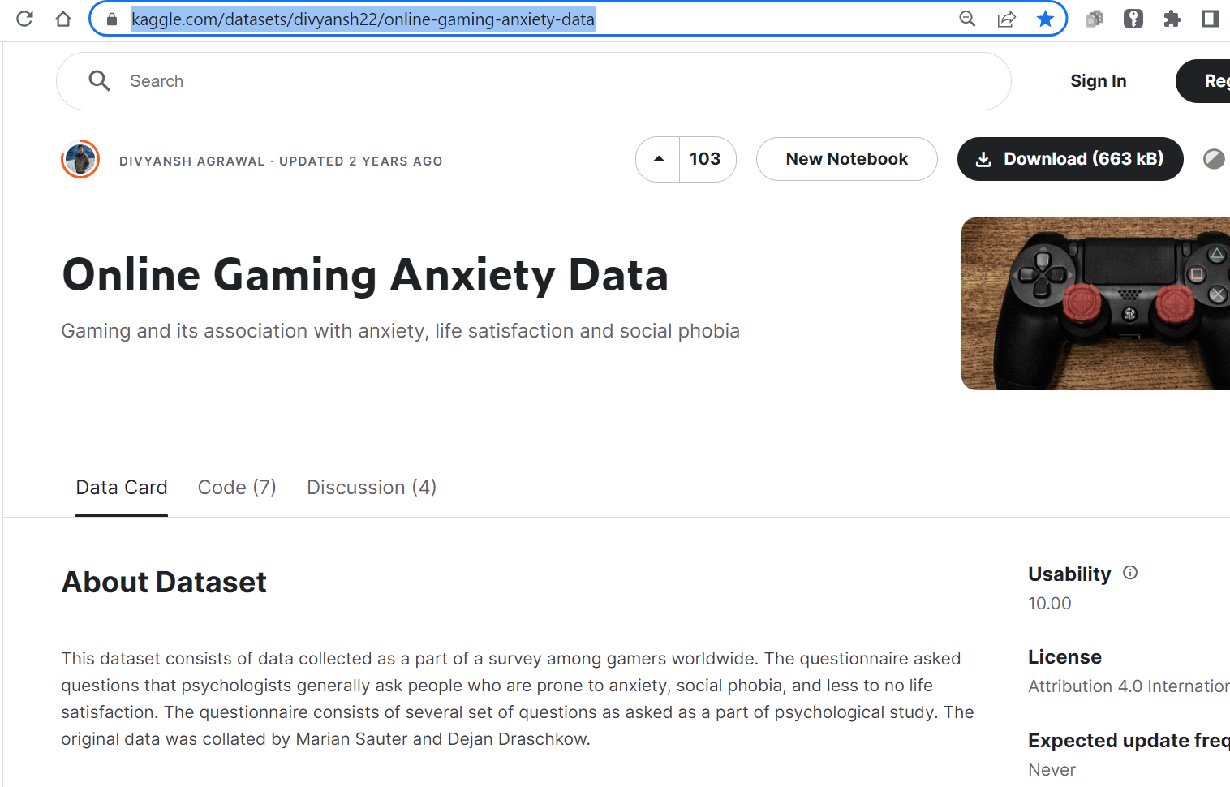
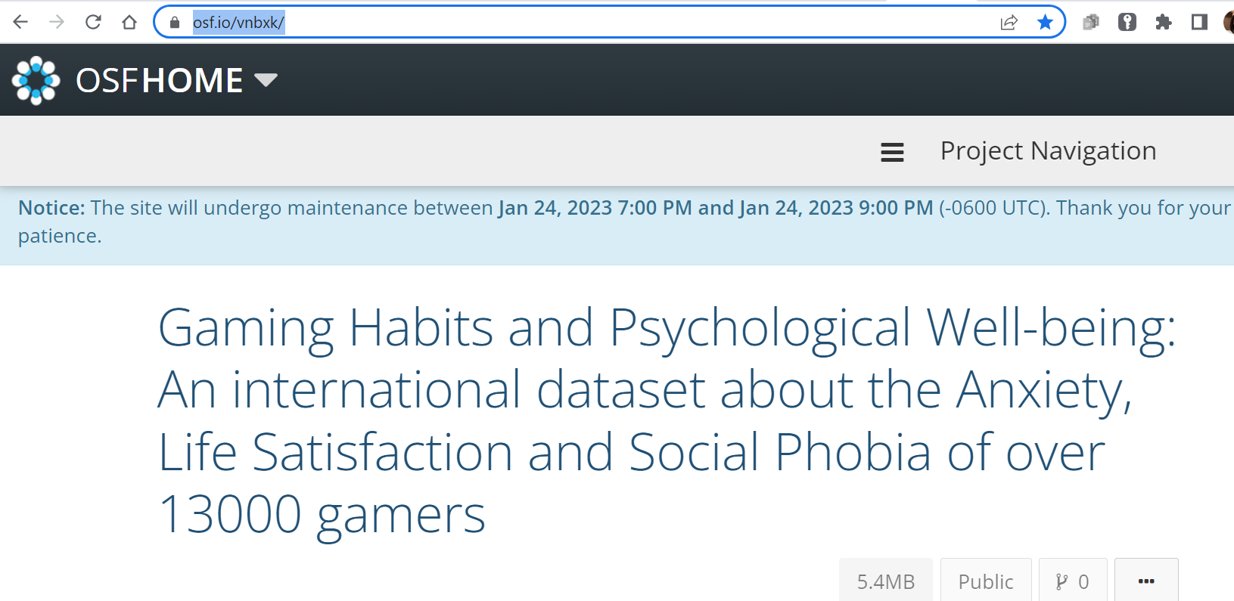
Question?
Do video games have a positive effect on mental health symptoms?
OR
Do video games have a negative effect on mental health symptoms.
To answer this question, I will conduct an analysis using the raw data from the site below.
ORIGINAL STUDY BELOW:
https://osf.io/vnbxk/
https://www.kaggle.com/datasets/divyansh22/online-gaming-anxiety-data

Slide 7
Data wrangling
The raw data was loaded into Python via Jupyter Notebook. Before I could analyze the data, the data needed to be wrangled.
There are over 50 columns. I didn’t need every column to analyze the data.
I decided to measure/analyze the data listed under these columns:
GADE (The ability to game and do normal tasks like going to work),
GAD_T (Level of Anxiety), Hours (Hours Played),
SWL_T (Life Satisfaction), & SPIN_T (Social Phobia)

Slide 8
Analysis results
Independent Chi-Square Analysis
Steps to get my data ready:
I recoded my columns into categorical variables, dropped any columns not used in my analysis, removed any missing data, and conducted a contingency table.
After conducting the Chi-Square for 4 different variable scenarios:
All 4 tests have values that are less than 0.05, I will accept the Hypothesis

Slide 9
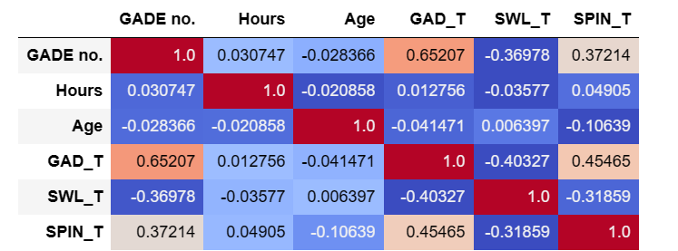
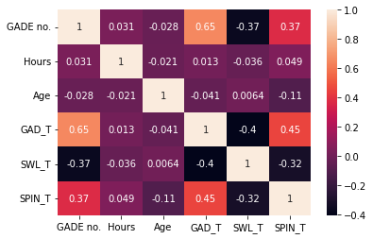
Analysis results
In both charts on the left, we have a visual representation of the correlation of all the variables represented in our analysis. So, do any of our variables (negative/positive) correlate to one another?
GADE (The ability to game and do normal tasks like going to work) Note: GADE no. is the numerical representation of this variable.
GAD_T (Level of Anxiety)
Hours (Hours Played)
SWL_T (Life Satisfaction)
SPIN_T (Social Phobia)
Positive Correlation- GADE no. & GAD_T, SPIN_T & GAD_T, and SPIN_T & GADE no.
There were 3 groups of positively correlated variables. For example, the level of anxiety and the gamer’s ability to do normal tasks could increase or decrease. Social phobia and the gamer’s ability to do normal tasks were positively correlated as well. These correlations would increase or decrease together instead of inversely like our example below.
Negative Correlation- SWL_T & GADE no. and SPIN_T & Age
There were 2 groups of negatively correlated variables. In other words, the more one variable increased the other variable decreased. For example, life Satisfaction could increase but the gamer’s ability to do normal tasks could decrease.

Slide 10
conclusion
In the beginning of this presentation, we asked if video games helped gamers with their mental health challenges? I believe my analysis supports my hypothesis (question). In other words, the positive correlations from the previous slide shows that if the number is high (i.e., the more severe the mental health challenge) there’s a higher chance of social phobia and the gamer’s ability to do normal tasks. These variables would be closely related to each other. Put another way, if a gamer with a high level of social phobia played video games, they could perform normal tasks more easily.

